Slide 1
Renewals
5 April 2011
Notes:
Renewals - <number>
Guidewire training materials contain Guidewire proprietary information that is subject to confidentiality and non-disclosure agreements. You agree to use the information in this manual solely for the purpose of training to implement Guidewire software solutions. You also agree not to disclose the information in this manual to third parties or copy this manual without prior written consent from Guidewire. Guidewire training may be given only by Guidewire employees or certified Guidewire partners under the appropriate agreement with Guidewire.

Slide 2
Lesson objectives
By the end of this lesson, you should be able to:
  Describe the functionality of renewals
  Create pre-renewal direction
  Create UW referral reasons
  Renew policies
  This lesson uses the notes section for additional explanation and information.
  To view the notes in PowerPoint, choose View→Normal or View→Notes Page.
  If you choose to print the notes for the lesson, be sure to select “Print hidden slides.”
Notes:
Renewals - <number>

Slide 3
Lesson outline
Renewal job basics
Pre-renewal directions
UW referral reasons
Working with renewal jobs
Notes:
Renewals - <number>

Slide 4

Renewals
renewal
current policy term
new policy term
Renewal extends policy into new term
  Creates new policy period
  May include change in coverages
  May include change in premium due to change in rates
This lesson details renewals in base application
  Keep in mind that process varies for each carrier and screens and is fully configurable
Notes:
Renewals - <number>

Slide 5
Starting renewals
automatic
manual
current term
new term
Typically started automatically
  Typically starts X days before expiration date
  "X" can vary based on nature of policy
Can be started manually
  Could be because of desire to start policy earlier than X days
  Could be because policy must change at time of renewal
Notes:
Renewals - <number>

Slide 6
Processing renewals
automatic
referral
current term
new term
Ideally, processing is entirely automatic
However, renewal can be referred to end user for review
  Could be result of business rules UW
  Could be as designated by end user before renewal begins
Notes:
Renewals - <number>

Slide 7
End results of renewal job
renewed
non-renewed
not taken
current term
new term
Renewed - policy continued for another term
Non-renewed - carrier fails to continue contract
Not taken - insured fails to continue contract
  If not renewed or not taken, old policy simply lapses when the expiration date arrives
Notes:
Renewals - <number>
An insured might choose to not renew a policy because he or she found a better-priced policy elsewhere, or because the policy premium has changed (perhaps because of changes in the industry or because of claims made against the original policy) and the insured does not wish to pay the new premium.
A carrier might choose to not renew a policy because the policy is considered financially unfavorable (perhaps because too many claims were filed against the policy).
Renewals can be highly regulated from state to state. There are restrictions in some states relating to non-renewal because of losses. There are also restrictions in many states relating to rate increases on renewals in excess of a given percent. And, there are restrictions in essentially all states relating to the carrier non-renewing without providing a specified amount of prior notice. Renewal regulation at a state level is largely a consumer protection issue. It is focused principally on personal lines (homeowners, personal auto) and harder to place on commercial lines.
In some cases, a policy may be renewed "short term". This means that the policy is renewed but it is not renewed for the full term (and typically for only a small fraction of the full term). One common situation where this is done involves cancellation. When a carrier cancels a policy, state laws may stipulate that the carrier must provide a certain amount of advanced notice (say, for example, 60 days) prior to the policy being cancelled. If the carrier wants to cancel the policy but the policy is due to be renewed within the advanced notice period (say, for example, the policy is due to be renewed in 45 days), then the carrier may renew the policy for a short period of time simply to provide the appropriate amount of advanced notice (for example, 15 days).

Slide 8
Pre-renewal directions
pre-renewal:
non-renewed
Special note attached to policies that identifies how renewal should be executed
  Three broad directions:
    Non-renew
    Not taken
    Refer to an individual for review
  Policy can have, at any given time, only one active pre-renewal direction
Notes:
Renewals - <number>
If a policy has a pre-renewal direction, you can either delete it or change it. (For example, you could delete a non-renew direction, which would mean the policy would in fact renew. Or, you could change a non-renew direction to a not taken direction.) But, you could never have two or more pre-renewal directions for a single policy.
You cannot create pre-renewal directions for a policy period which has already been renewed.

Slide 9

UW referral reasons
policy
submission/renewal
UW referral
reason
UW issue
UW referral
reason
A UW referral reason is a record that identifies risk information relevant to a renewal
  Similar to UW issues
  Unlike UW issues (which are created only during submissions and renewals), UW referral reasons can be created at any time, even when there is no active transaction

Slide 10
UW referral reason life cycle
policy
submission/renewal
referral
reason
UW
issue
approved
UW
issue
referral
reason
approved
UW
issue
UW referral reasons can be created manually at any time
During renewal process:
  Open UW referral reasons are copied over to UW issues and approved or rejected
  Open UW issues must be approved before renewal can be completed

Slide 11
Lesson outline
Renewal job basics
Pre-renewal directions
UW referral reasons
Working with renewal jobs
Notes:
Renewals - <number>

Slide 12
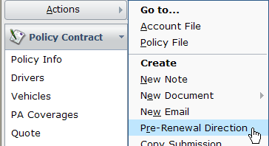
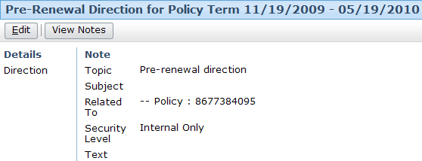
Pre-renewal direction screen
Notes:
Renewals - <number>
The pre-renewal direction screen can be displayed by clicking the "Pre-Renewal Direction" menu action.
If a policy has no pre-renewal direction, then the pre-renewal direction screen is initially blank (as shown above).
To create a pre-renewal direction (or modify an existing one), click Edit.

Slide 13
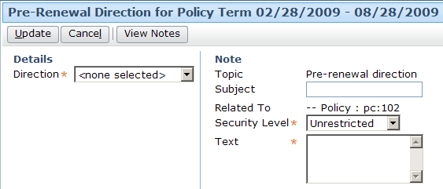
Creating a pre-renewal direction
pre-renewal fields
note fields
Notes:
Renewals - <number>
A pre-renewal direction is essentially a note with some additional fields. The additional "pre-renewal specific" fields appear on the left side of the screen (to the left of the vertical line). The basic note fields appear on the right side of the screen (to the right of the vertical line).
Creating (or changing) a pre-renewal direction also adds an entry to the policy's History.

Slide 14
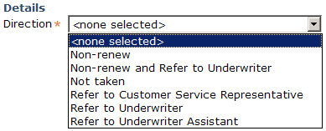
Pre-renewal direction choices
Non-renew
Not taken
Refer to (person)
Also, additional non-renew plus refer to underwriter
Notes:
Renewals - <number>
Out of box, you can specify that the renewal job should:
End in non-renewal
End in not taken
Be referred to a customer service representative, underwriter, or underwriter assistant
If the job should end in renewal without review by a person, then you should not create a pre-renewal direction
If the pre-renewal direction for a policy is a "refer to..." direction, then it is the business practices of the carrier that determines whether the referral should go to a customer service representative, an underwriter, or an underwriter assistant.
Pre-renewal directions do not absolutely dictate how a renewal job is processed. For example, a pre-renewal direction could indicate a policy should be non-renewed, but during the renewal job the policy might be turned over for manual processing.

Slide 15
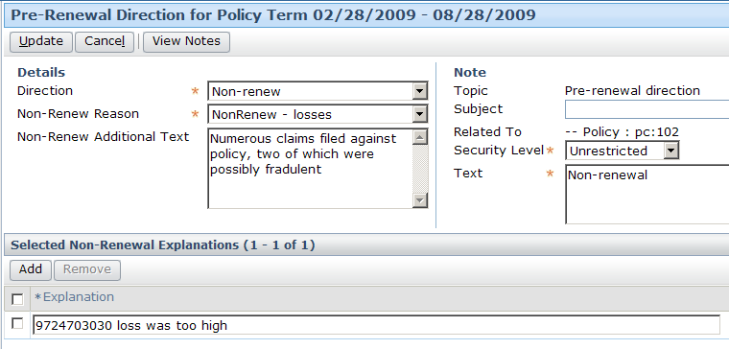
Example: Non-renewal PRD
Notes:
Renewals - <number>
When you create a pre-renewal direction of type non-renew:
Two additional pre-renewal fields appear (Non-Renew Reason and Non-Renew Reason Additional Text). The Non-Renew Additional Text field is for any text you want to display at the pre-renewal direction level but not have visible when viewing just the policy notes.
You can optionally add one or more "Selected Non-Renewal Explanations" by clicking the Add button at the bottom of the screen and choosing one or more reasons from the list of reasons provided.

Slide 16
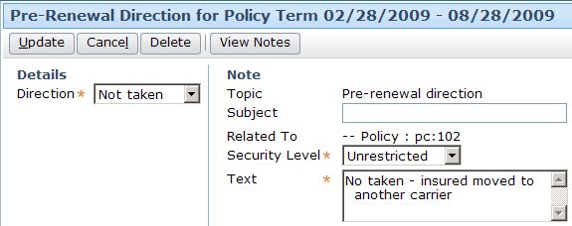
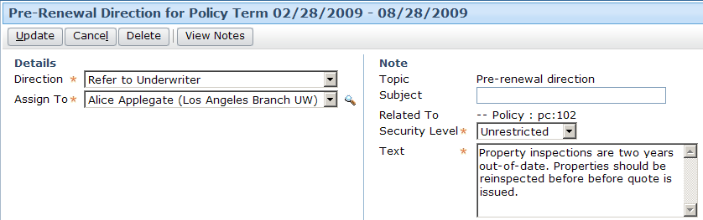
Example: Not taken and "Refer To..." PRDs
Notes:
Renewals - <number>
When you create a pre-renewal direction of type not taken, no additional fields appear.
When you create a pre-renewal direction of type "refer to...", an additional field appears to let you identify who to refer the renewal job to once the job has started.

Slide 17
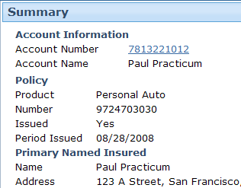
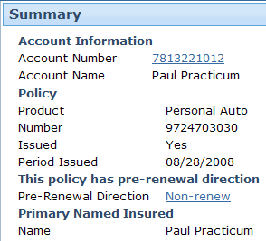
Viewing an existing pre-renewal direction
If policy has a pre-renewal direction, Summary screen identifies this
  You can view pre-renewal direction in detail by clicking link
Notes:
Renewals - <number>
If a policy does not have a pre-renewal direction, then the pre-renewal direction widgets are not visible.

Slide 18
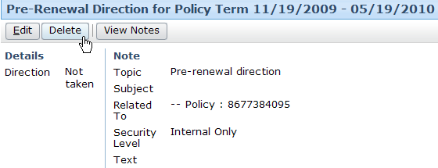
Removing pre-renewal direction
You can remove pre-renewal direction
  Record of direction still exists, but renewal executed as if it never existed
Notes:
Renewals - <number>
To remove a pre-renewal direction, click the Delete button. When the pre-renewal direction is removed, the renewal job will presumably renew the policy and do so without referring it to any individual.

Slide 19
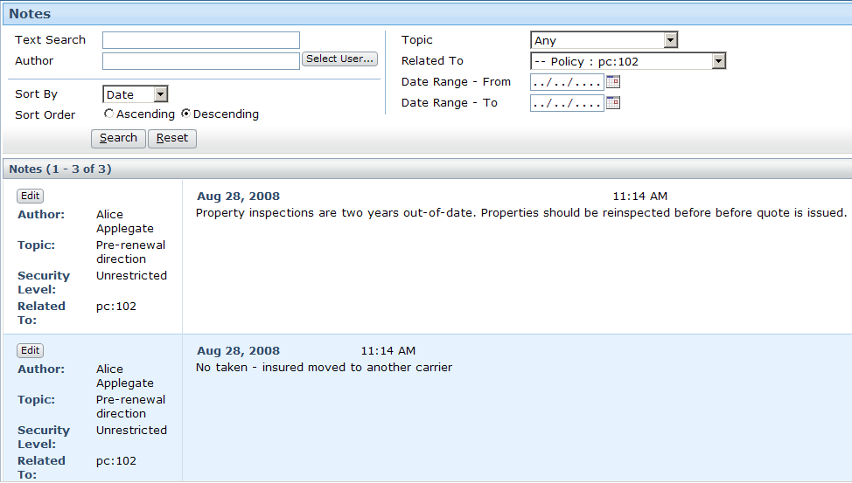
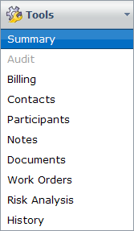
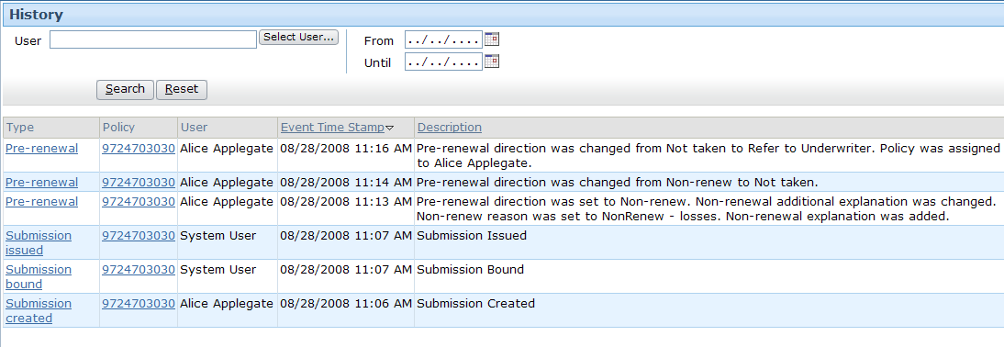
Viewing past pre-renewal directions
PRD notes appear among all policy notes
Each PRD recorded in policy history
Notes:
Renewals - <number>
When you view the Notes for a policy, pre-renewal directions appear there along with all other non pre-renewal direction notes. If you modify a pre-renewal direction multiple times, each version of the pre-renewal direction appears in the Notes list. When viewing a pre-renewal direction from the policy file, you can jump to the list of notes by clicking the View Notes button.

Slide 20
Lesson outline
Renewal job basics
Pre-renewal directions
UW referral reasons
Working with renewal jobs
Notes:
Renewals - <number>

Slide 21
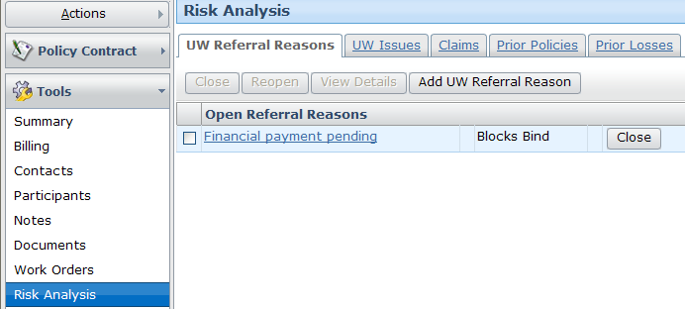
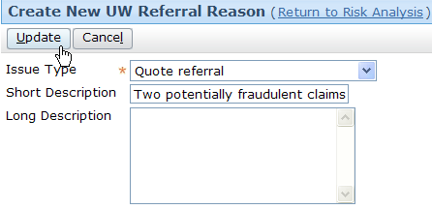
Creating UW referral reasons

Slide 22
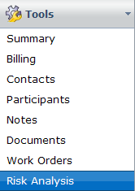
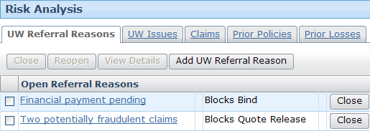
Viewing referral reasons

Slide 23
Lesson outline
Renewal job basics
Pre-renewal directions
UW referral reasons
Working with renewal jobs
Notes:
Renewals - <number>

Slide 24


Renewal wizard
Edit
Contract
View
Quote
Billing
Info
Forms
Bind
Renewal
Used only for renewals where:
  Renewal must be started manually, and/or
  Policy is to change at renewal time
Notes:
Renewals - <number>
The renewal wizard governs the manner in which information about the renewal job is gathered and displayed in the user interface. This wizard is relevant only for renewals which are started manually or renewals which are referred to end users.

Slide 25
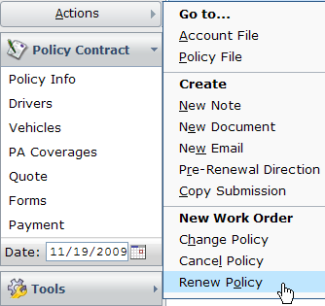
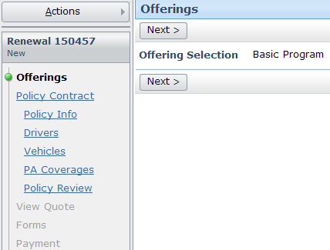
Initiating renewals manually
If there is no need to modify policy, you can exit wizard immediately

Slide 26
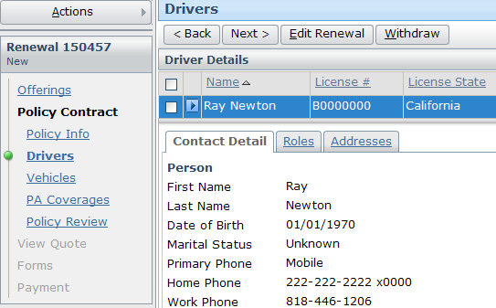
Modifying the policy
Notes:
Renewals - <number>
You can click the Edit Renewal button which makes the policy editable. The set of buttons on the top will also update with the Renewal button set.

Slide 27
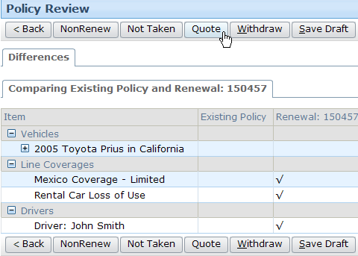
Quoting the renewal (1)
Tree like structure displays the difference from the original policy
Notes:
Renewals - <number>
The renewal is automatically quoted by the renewal workflow. This amount of time that passes between the start of the renewal and the quote can be configured. In a live implementation, it could be several days, during which information relevant to the quote is gathered from other systems (such as the claims system). In a test instance, it could be as short as a few seconds.
The user can also click on the Quote button to obtain the quote at any point in the Renewal wizard.

Slide 28
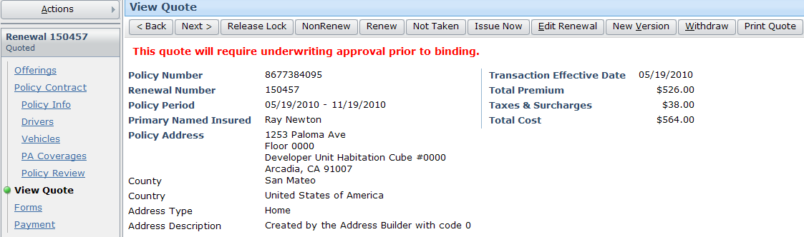

Quoting the renewal (2)
After Quoting the Forms and Payment pages are available
Extensive button set is displayed
Notes:
Renewals - <number>
If there are UW issues blocking the Quote then an appropriate message is displayed.
In the example above, there are UW issues blocking bind, so an appropriate message is displayed for the user, and the bind options are not displayed.
If there are not issues blocking bind or quote then the user will be able to issue the policy and the appropriate buttons are displayed.

Slide 29
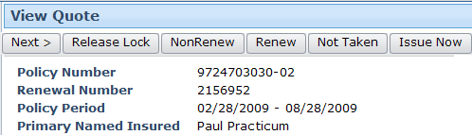
Manually completing the renewal
Issue Now button:
  Completes transaction immediately
  Renews policy
All other buttons complete transaction as of effective date with corresponding status

Slide 30
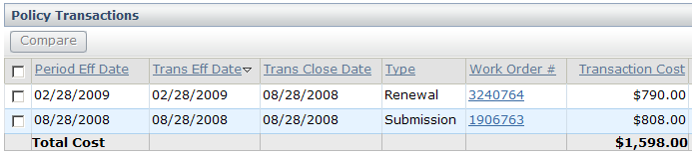
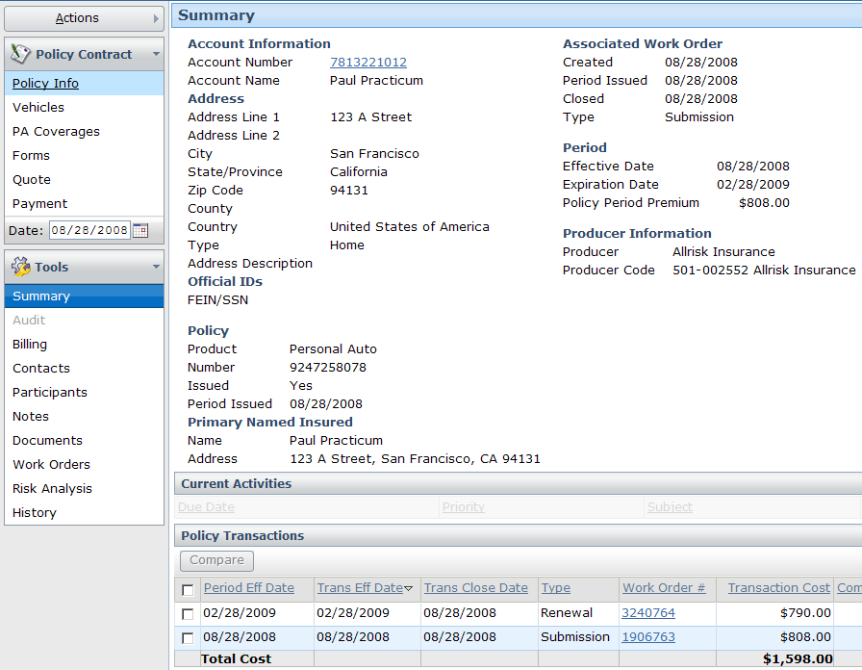
Completed renewal

Slide 31
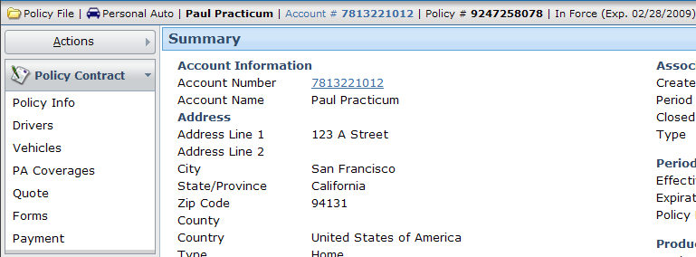
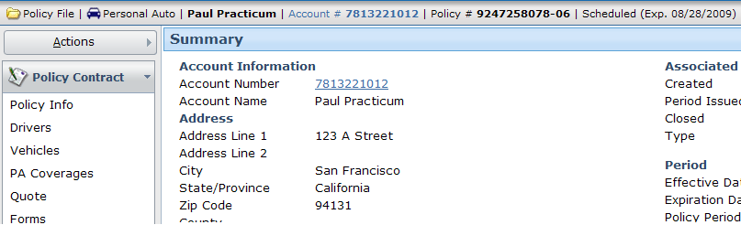
Current and future policy periods
Policy number is modified
Status of policy is "Scheduled"

Slide 32
Lesson objectives review
You should now be able to:
  Describe the functionality of renewals
  Create pre-renewal direction
  Create UW referral reasons
  Renew policies
Notes:
Renewals - <number>

Slide 33
Review questions
What are the three ways that a renewal can end?
Under what two circumstances does the renewal wizard typically get used?
How many pre-renewal directions can a policy have?
When should you not create a pre-renewal direction?
Assume that a policy has a term of one year, and that first year ends in 15 days. A renewal job should already have been started for that policy. How can you tell if the renewal job is still in progress or has been completed?
Notes:
Renewals - <number>
Answers
1. Renewed, non-renewal (when the carrier chooses not to renew the policy), not taken (when the insured chooses not to renew the policy).
2. The renewal wizard typically gets used when the renewal is started manually or when the policy must be changed at renewal time.
3. A policy could have any number of pre-renewal directions, but there is always only one active pre-renewal renewal direction.
4. You should not create a pre-renewal direction if you want to renew the policy and do not need any human review of the job while it's being executed.
5. You can look in the Summary Screen for the policy. If the renewal job is listed in the "Policy Transactions" list, it has been completed. If it is listed in the "Work Orders in Progress" list, it is still in progress.

Slide 34
Notices
Copyright © 2001-2011 Guidewire Software, Inc. All Rights Reserved.
Guidewire, Guidewire Software, Guidewire ClaimCenter, Guidewire PolicyCenter, Guidewire BillingCenter, Guidewire Reinsurance Management, Guidewire ContactManager, Guidewire Vendor Data Management, Guidewire Client Data Management, Guidewire InsuranceSuite, Guidewire ContactCenter, Guidewire Studio, Gosu, Deliver Insurance Your Way, and the Guidewire logo are trademarks or registered trademarks of Guidewire Software, Inc. in the United States and/or other countries.
This material is Guidewire proprietary and confidential. The contents of this material, including product architecture details and APIs, are considered confidential and are fully protected by customer licensing confidentiality agreements and signed Non-Disclosure Agreements (NDAs).
This file and the contents herein are the property of Guidewire Software, Inc. Use of this course material is restricted to students officially registered in this specific Guidewire-instructed course, or for other use expressly authorized by Guidewire. Replication or distribution of this course material in electronic, paper, or other format is prohibited without express permission from Guidewire.
    Guidewire products are protected by one or more of the following patents: U.S. Patent No. 7,885,831; U.S. Patent No. 7,788,296.
Notes:
Introduction to Guidewire Configuration - <number>

